Slide 1
SOCIAL CHAMPION IDENTIFICATION
(Group no:3)
Developed by:
1. Mansi Khamkar
2. Reshma Khot
3. Ruchita Yeole
4. Pinky Rathod

Slide 2
How we perceived the problem?
Every NGO has database of donors
These donors are trustworthy and can help in publicizing the NGO
To find out which donors are more interested in social work
To get interested individuals from NGO and donor accounts who may become donors or promoters for the NGO

Slide 3
How our system solves the problems?
Scanning NGO accounts, pages, groups and events to fetch individuals who have interacted
Getting facebook and twitter authentication from donors and promoters
Scanning their facebook and twitter profiles and timelines to rank their interest in social work
Assigning points to donors, promoters and fetched individuals based on their activities and ranking them

Slide 4
Scan results
List of facebook, twitter and average points of donors and promoters ordered by rank
Prospective individuals fetched from facebook with their points
Prospective individuals fetched from twitter with their points
List of profiles(pages, groups, events) fetched with their mentions.
Link to all profiles

Slide 5
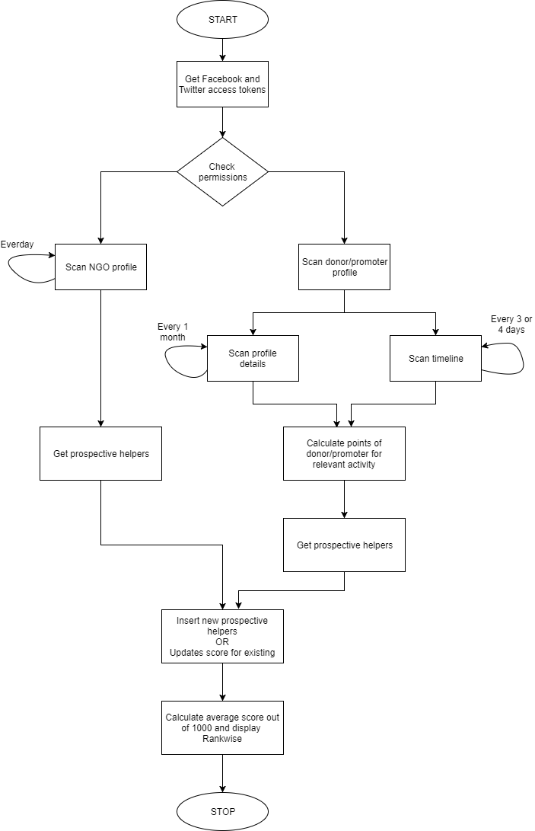

Slide 6
What we are scanning through profiles
Facebook
Page:
Page Admin
Page rating and reviews
Page Feed (own posts, tagged posts, visitor posts) (from, tags, shares, comments, reactions)
Group:
Group Admin
Members of group
Group feed (from, tags, shares, comments, reactions)
Event:
Event Admin
Individuals attending the event
Individuals interested in the event
Event feed (from, tags, shares, comments, reactions)
User account:
Account details (work, education, about, owned pages & groups, events)
Timeline feed (from, tags, shares, comments, reactions)

Slide 7
What we are scanning through profiles
2. Twitter
Account:
Account profile
Timeline feed likes, retweets, comments,mentions
List:
List Owner
List members
List subscribers

Slide 8
Features
Our system is flexible to new social media platforms and points
The system fetches almost all users that have interacted with the ngo profiles on facebook and twitter
Social champions are ranked and linked to their social accounts
Includes custom scan

Slide 9
Technology ,Cost and Deployment
Technology used:
Platform: web
Front end: HTML, CSS, JQuery, Bootstrap
Back end: PHP, MySQL, Ajax, Json
APIs Used: Facebook Graph API(V 2.10),Twitter Rest API(V 1.1)
Cost:
It does not require any cost to implement and to use this project
Deployment:
Web domain or a local server
MySQL database
Good Internet availability
Facebook and Twitter App (created on developers site)

Slide 10
THANK YOU!

